Slide 1

计算机专业
本科生工作问题
时间：2024年4月

Slide 2

目录
01
02
03
04
Development Direction
Industry Status
Job Hunting
My feelings
发展方向
行业现状
关于工作
我的感想

Slide 3
01
Development Direction
发展方向

Slide 4
Postgraduate
recommendation
保研
Postgraduate entrance examination
考研
What are your options？
Job Hunting
工作
Civil service examination
考公

Slide 5
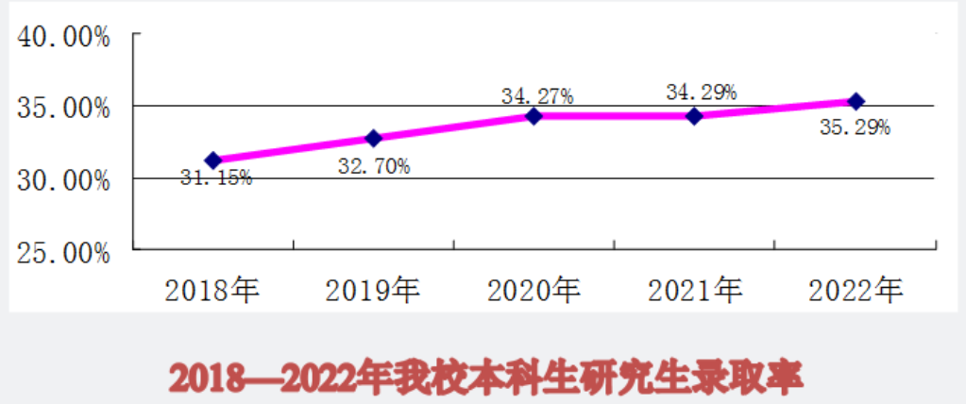

Slide 6
02
Industry Status
行业现状

Slide 7
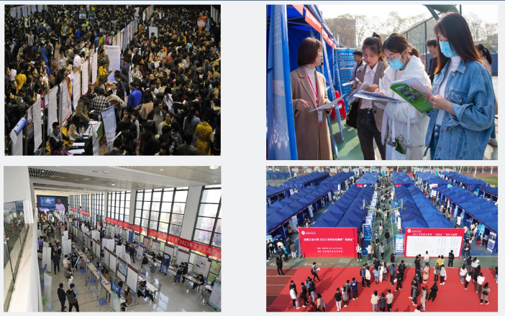

Slide 8
SWOT
superiority
weakness
S
W
The digital future;
Logical thinking and problem solving ability;
Broad career options and development space.
Short career life； Physical health problems
opportunity
threaten
O
T
Frontier science and technology；
Have more opportunities.
The rapid development of AI

Slide 9






Slide 10

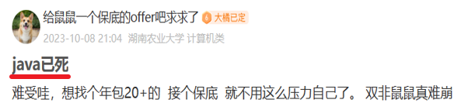




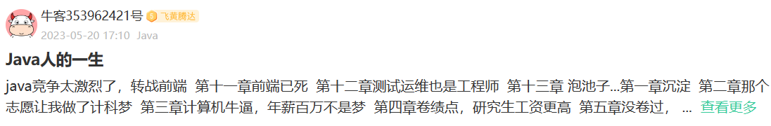


Slide 11


Slide 12
03
Job Hunting
关于工作

Slide 13
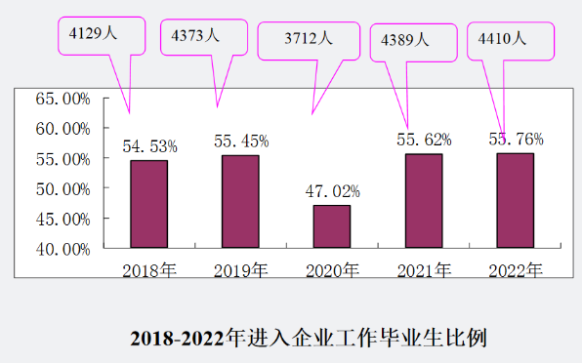
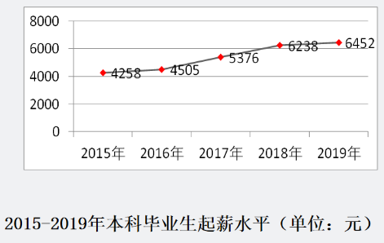

Slide 14
Development jobs
or
R&D jobs(Algorithmic positions)
?
开发？研发？
测试？运维？

Slide 15


Front-end development
Back-end development
前 端
后端
其他
Test
测试
运维
Operation and maintenance

Slide 16
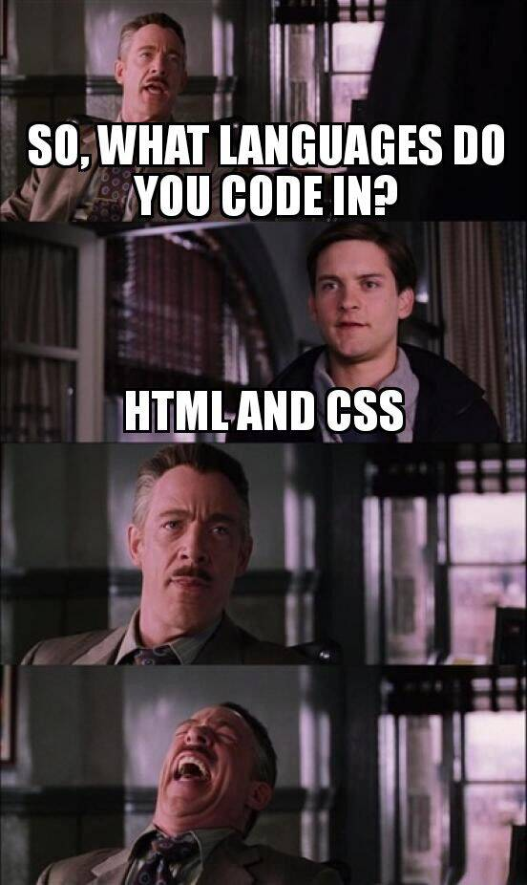

Front-end development
前端开发
Front-end development is a type of computer programming, which mainly focuses on the interaction and experience of users in web pages or applications.
It involves the layout, color, font and animation of the page, and how to deal with the user's input and feedback.
Generally speaking, the front-end developer's job is to integrate the designer's design scheme with the back-end developer's data interface, so that users can see and use that part of the product, which is called the client.

Slide 17

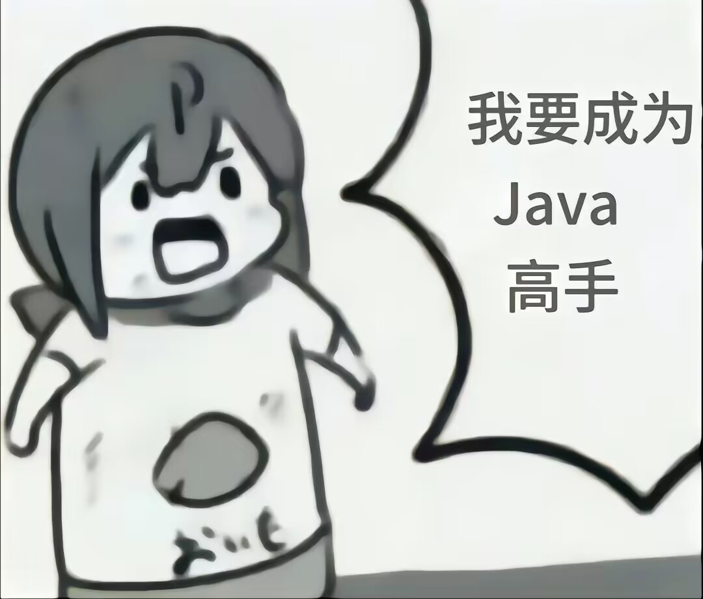

Back-end development
后端开发
Back-end development refers to the development work carried out on the server, which supports the running of front-end applications or websites. The back end is usually responsible for handling core functions such as database operation, server logic, authentication and authorization.
The main tasks of back-end development include:
1. Database management: create, read, update and delete data (these operations are usually called CRUD operations).
2. Server programming: Write codes that can handle user requests, handle business logic and interact with the database.
3.API (Application Programming Interface) development: Create an API to enable front-end applications to communicate with back-end data and logic.
4. Management of the server, network and hosting environment: ensure the normal operation of the application on the server, and deal with the configuration and security issues related to the network.

Slide 18
04
My feelings
我的感想

Slide 19


Slide 20
不要过于焦虑
Be moderately nervous, but not overly anxious
Study continuously and efficiently for at least 3 hours every day
注意学习时间和效率
Don't be too influenced by what others say and think rationally
学会理性思考
Find your own path
找适合自己的路
实干、
持之以恒
Get on with it and persevere

Slide 21
Thank you for listening.
时间：2024年4月

